Slide 1
Aspect Based Sentiment Analysis
Presented By :
Shubham Kumar
Tejas Shinde

Slide 2
Introduction
Comparison to Normal Sentiment Analysis
Problem : Unable to determine Positive or Negative

Slide 3
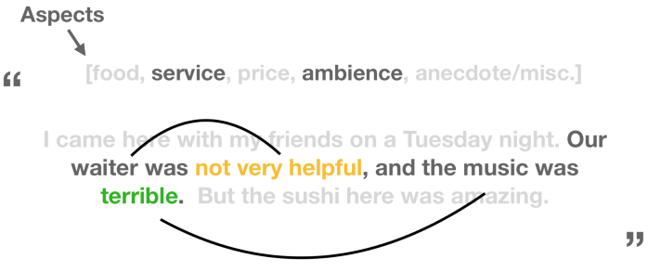
Sentiment and Aspects

Slide 4
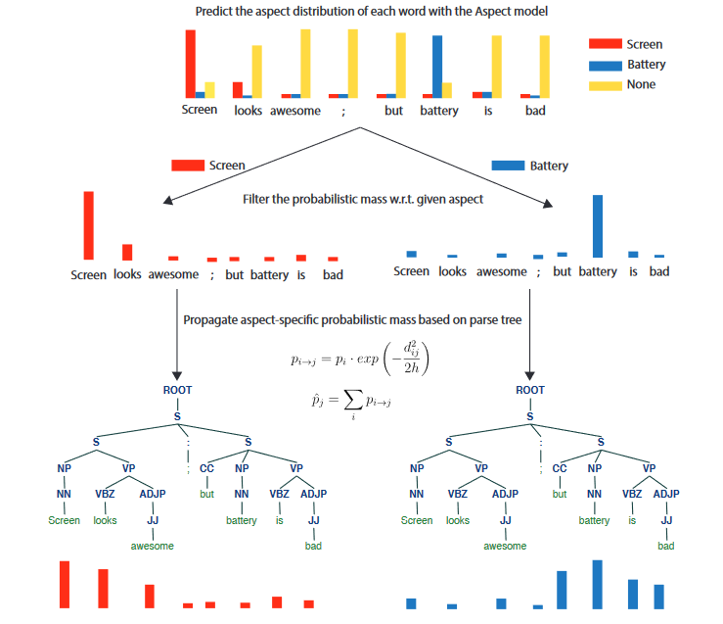
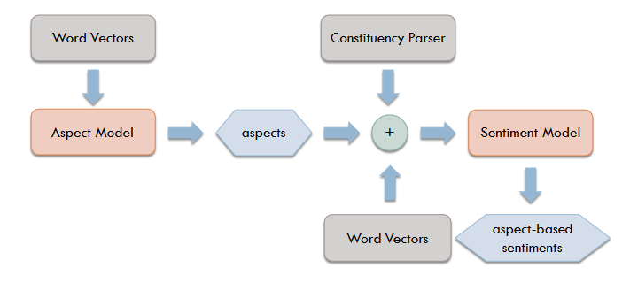
The Deep Learning Way

Slide 5
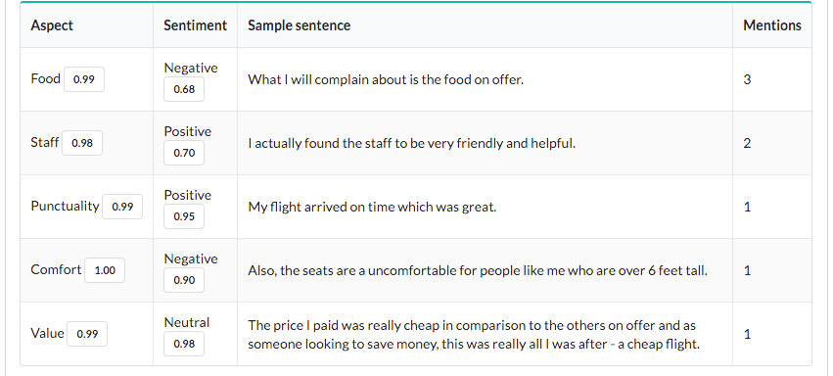
Methodology

Slide 6
Importance
Scalability
Consistent Criteria
Real Time Analysis
Deeper Customer Understanding

Slide 7
Applications
Understand Aspects
Granularity
Can be used to tackle competitors
Track customer sentiment changes towards features/attributes of a product
Determine the customer’s navigation through an application or a website(An older person may find it hard to navigate in a travel website than a comparatively younger person)
Customer Support

Slide 8
References
https://aylien.com/text-api/aspect-based-sentiment-analysis/
https://monkeylearn.com/blog/aspect-based-sentiment-analysis/
https://medium.com/@pmin91/aspect-based-opinion-mining-nlp-with-python-a53eb4752800
https://cs224d.stanford.edu/reports/WangBo.pdf

Slide 9
Thankyou!

